Slide 1
Github + Login Info for Super Servoli Systems
Email : gm34700p@pace.edu
Password : Abc987!@#
Repository : https://github.com/AndyM123/CS691

Slide 2
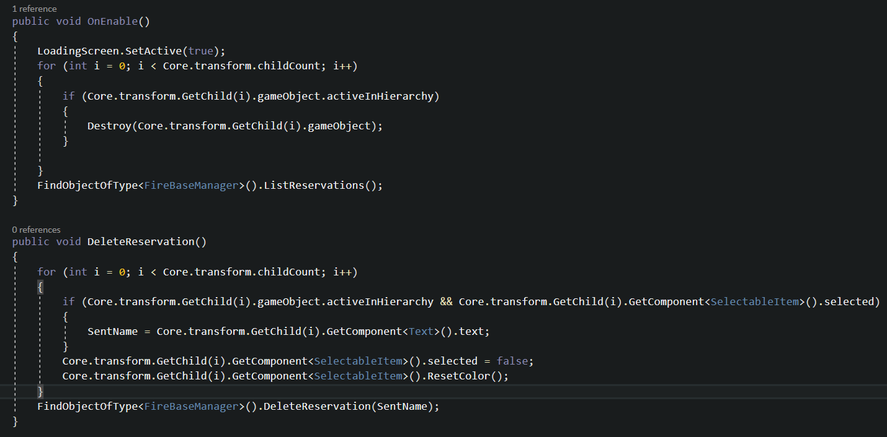
Source Code Sample 1

Slide 3
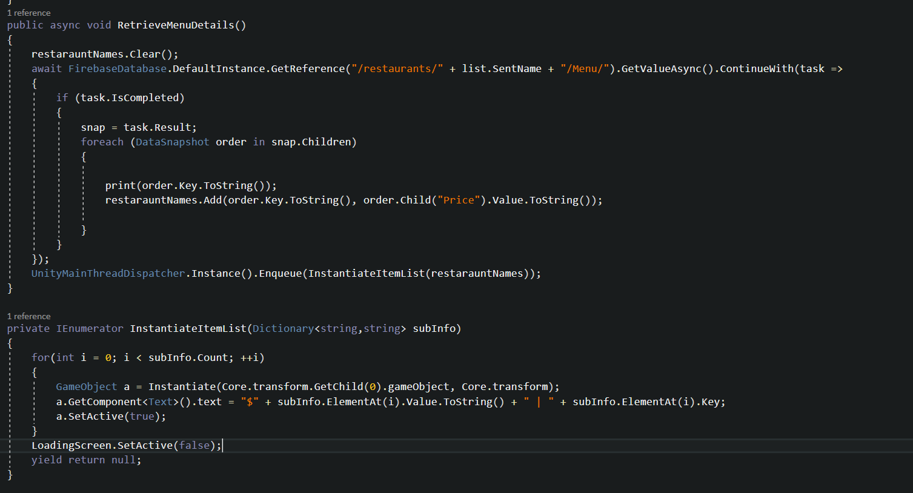
Source Code Sample 2

Slide 4
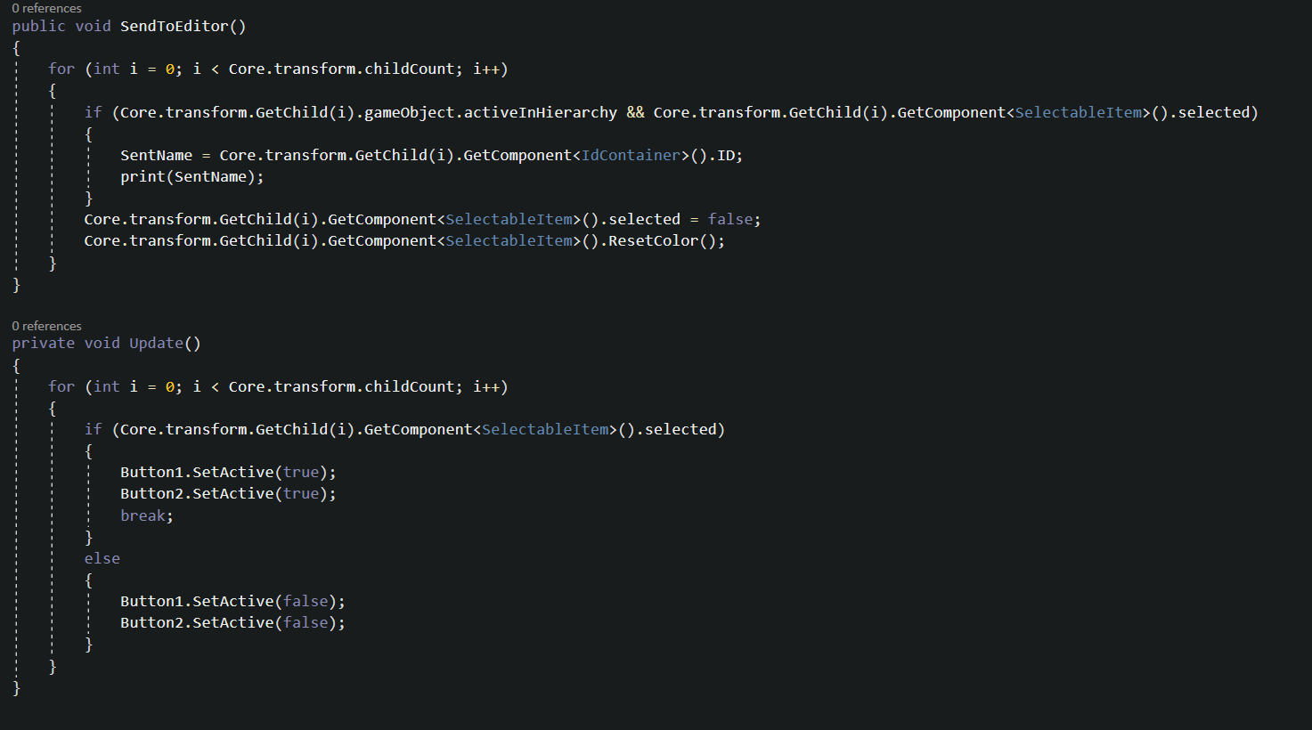
Source Code Sample 3

Slide 5
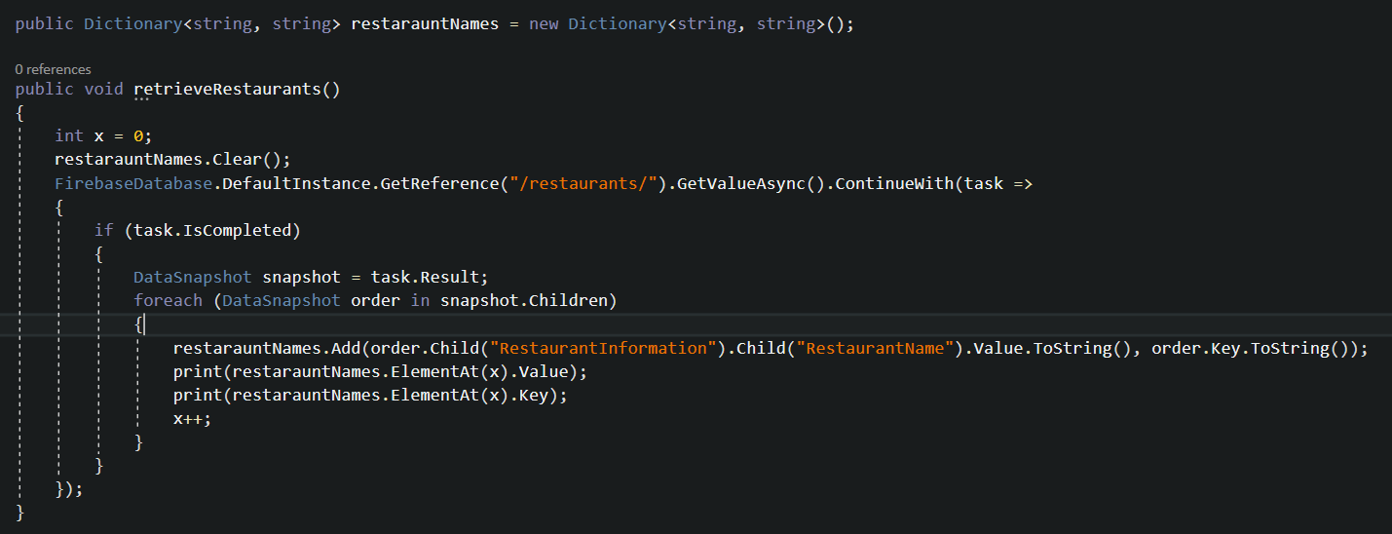
Source Code Sample 4

